Slide 1

Department of Information Technology
NBA Accredited A.P. Shah Institute of Technology G.B.Road, Kasarvadavli, Thane(W), Mumbai-400615
UNIVERSITY OF MUMBAI Academic Year 2021-2022

Slide 2
A Project Presentation on
Air Quality Index Prediction
Submitted in partial fulfilment of the degree of Bachelor of Engineering (Sem-6) in INFORMATION TECHNOLOGY by
Yugandhar Ghatge (19104046) Mayuri Patil (19104012)
Abhijeet Mishra (19104019) Under the Guidance of Prof. Neha Deshmukh

Slide 3
1.Project Conception and Initiation

Slide 4
1.1 Objectives
To predict the air quality index and study about the climate conditions.
To backtrack and research about the major pollutants that affects the AQI & minimize air pollution.
To know the reasons behind the AQI for that respective locality.
To reduce the efforts & resources in manual calculation of Air Quality Index(AQI).

Slide 5
1.2 Literature Review
No. | Author | Paper title | Key Findings
1. | Anikender Kumar, PramilaGoyal | Forecasting of daily air quality index in Delhi | Forecasting using previous records with PCR and multiple regression techniques.
2. | Huixiang Liu | AQI and Air Pollutant Concentration Prediction Based on ML Algorithms | Predicting concentration of Noxin using datasets
3. | Aditya C R | Detection and Prediction of Air Pollution using ML Models | ML algorithms to predict PM 2.5 values

Slide 6
1.3 Problem Definition
With increasing industrialization and urbanization, air quality is drastically changed which leads to adverse effects on human life and nature.
One of the major issues faced by the urban settlements are the diseases cause due to the rising pollution level. Air pollution is the major problem and ignoring it is more severe.
Photographic method is not sufficient to calculate PM 2.5 taking only limited pollutants in consideration.

Slide 7
1.4 Scope
Air Quality Index Prediction is specially designed for to calculate AQI for environmental organizations as well as civilians.
With the entry of basic climatic records, AQI of that region can be generated.
It also helps in identifying faulty standards and inadequate monitoring programs.
This application helps in understanding the air quality thereby alerting us and taking respective measures.

Slide 8

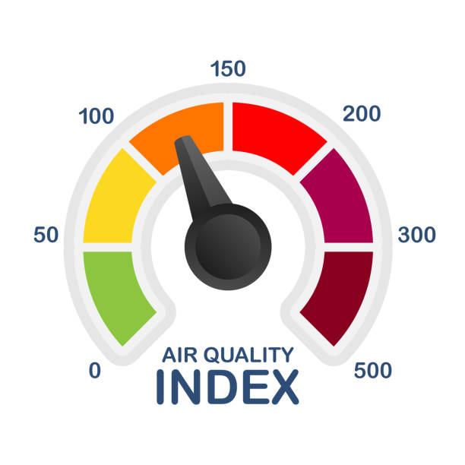
1.5 Technology stack
Framework :- Html | Bootstrap
ML algorithm :- RandomForestRegressor
API :- Weather API (openweathermap.org)
Other technologies : - Pycharm, Jupyter Notebook, etc.

Slide 9
2. Project Design

Slide 10
2.1 Proposed System
Air Quality Index Prediction is designed to secure the aerial life of humanity. The air quality index is an index for reporting air quality on daily basis.
Machine learning algorithms make it easy to predict the PM 2.5 value and with simple steps, AQI of any desired city can be obtained.
The aim is to investigate machine learning based technique for air quality forecasting using AQI index by predicting results in best accuracy.
This system proves beneficial for cities as well as environment departments to take early actions.

Slide 11
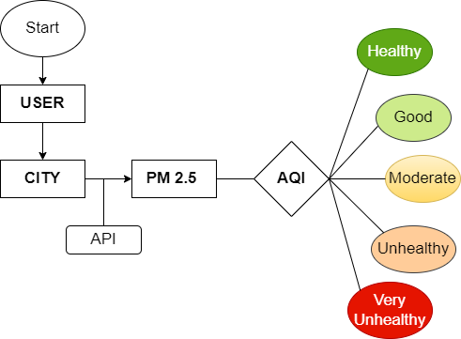
Fig. Workflow

Slide 12
2.2 Design
Data collection :
Using the weather API, climatic factors data of a particular city is collected.
Prediction :
The main feature includes predicting the quality of air. Based on the given city input of the user, the model predicts the Air Quality Index for that city.
Environment :
According to the PM 2.5 value, Air Quality Index range can be figured out as unhealthy or healthy.

Slide 13
3. Implementation

Slide 14
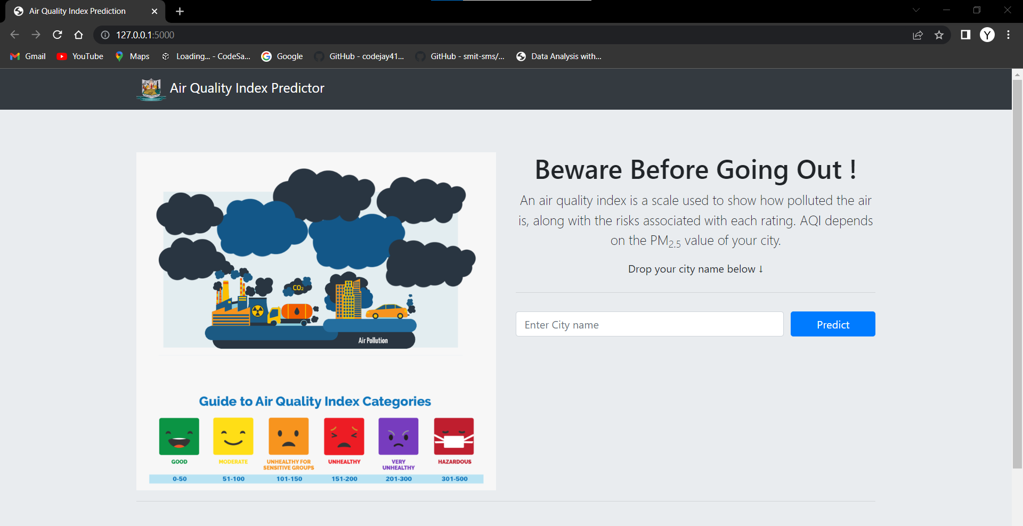
Fig 1 : User Interface

Slide 15
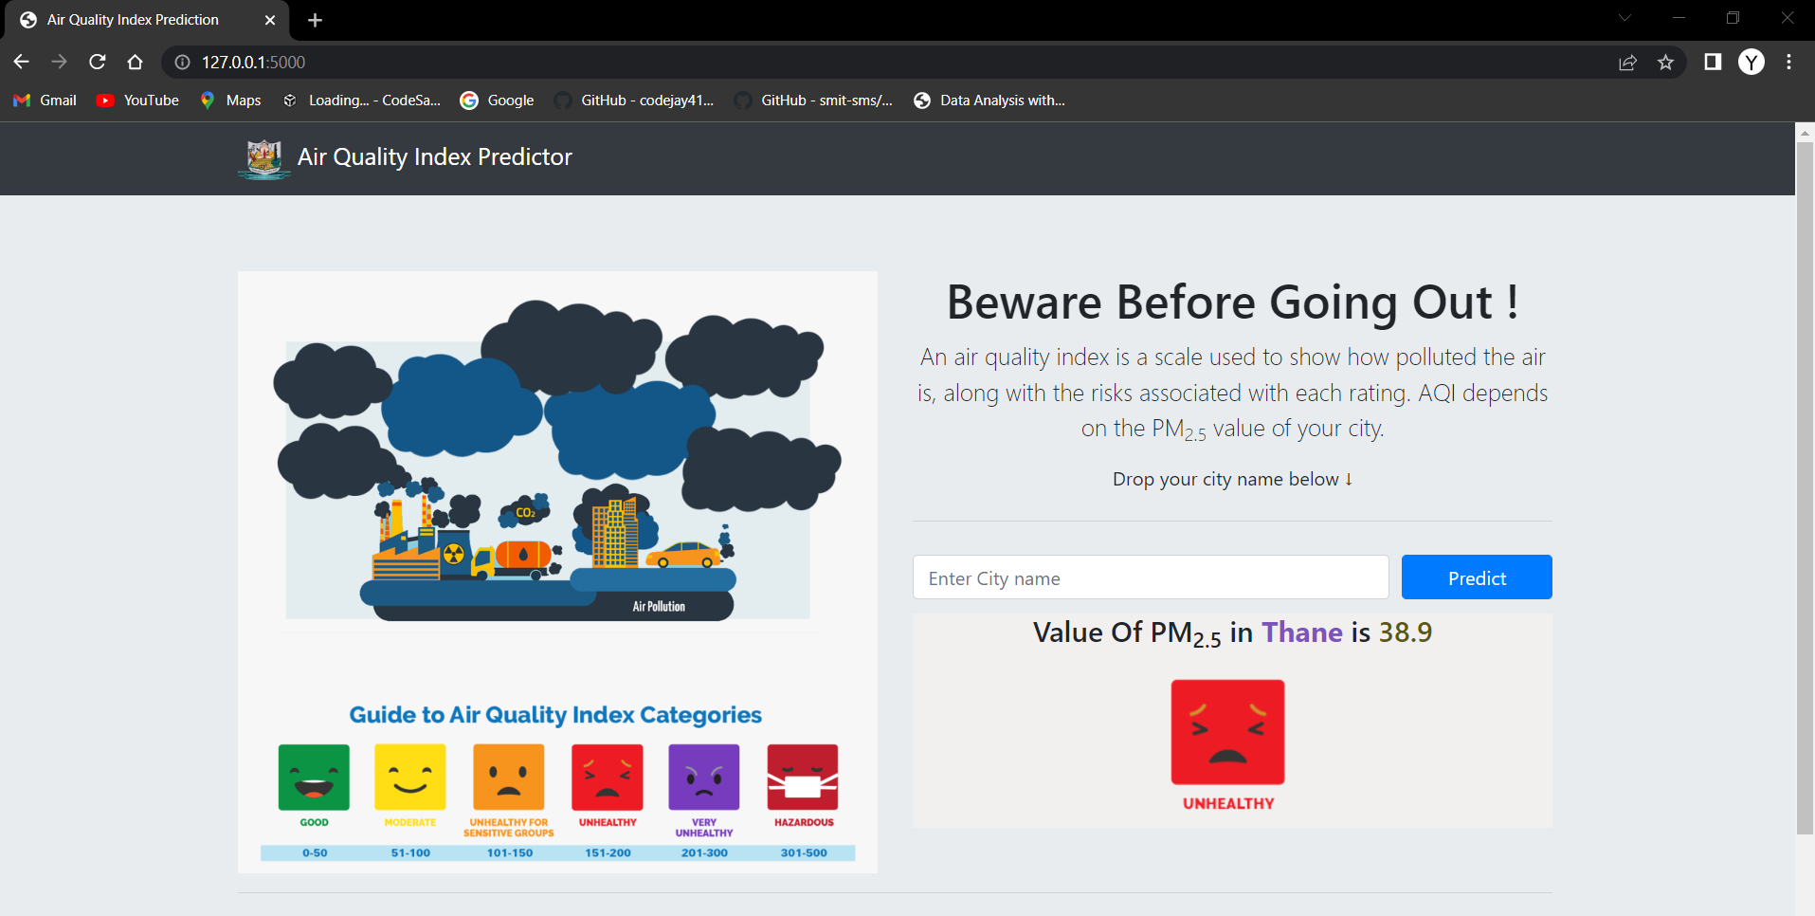
Fig 2 : AQI Prediction

Slide 16
4. Result

Slide 17
Air Quality Index Prediction is capable of successfully predicting the upcoming AQI of any particular region.
This system will help in minimizing the amounts of pollutants in air.
The higher the AQI value, the greater the level of air pollution and the greater the health concerns.
AQI can be obtained anytime and anywhere as it is a system application.

Slide 18
5. Conclusion and Future Scope

Slide 19
According to the AQI, various environmental effects can be studied including social health. The ability to predict air quality enables the government and other concerned organizations to take necessary steps to shield the most vulnerable, from being exposed to the air with hazardous quality.
This system concentrates on the prediction of pollutants present in the air. By predicting the air quality priorly, we can take necessary steps to prevent future consequences. The exploratory data analysis and feature engineering methods implemented for the prediction models revealed interesting correlations between weather and pollution data. This system is completely user friendly and can be accessed anywhere and anytime.

Slide 20
References
https://openweathermap.org/api
https://www.bootstrapcdn.com/
Machine Learning With Random Forests And Decision Trees: A Visual Guide For Beginners by Scott Hartshorn
https://cpcb.nic.in/

Slide 21
Thank You

